Slide 1




DATA
SCIENCE
Presented By:
Arushi Arora
MCA - 2
A253145023029

Slide 2
WHAT IS DATA SCIENCE ?
Data Science helps us learn useful things from data.
It mixes math, coding, and business knowledge to find patterns and make smart decisions.

Slide 3
WHY DATA SCIENCE IS IMPORTANT?
01 - HELPS PREDICT TRENDS
02 - IMPROVE BUSSINESS
03 -FINDS HIDDEN PATTERNS

Slide 4
SKILLS REQUIRED FOR DATA SCIENCE
TABLEAU
R
SQL
PYTHON
POWER BI
EXCEL

Slide 5
FINANCE: Fraud detection
HEALTHCARE : Disease Prediction
APPLICATIONS OF DATA SCIENCE
CUSTOMER SERVICE : Call center analysis
CUSTOMER SERVICE : Call center analysis
Lorna Alvarado

Slide 6
CALL CENTER PERFORMANCE
Objective: Improve customer service in a call center
Enhance customer satisfaction.
What We Analyzed:
Call length (How long are calls?)
Customer satisfaction scores (Are customers happy?)
Agent performance (How well do agents solve issues?)

Slide 7
DATASET STRUCTURE
Attributes Overview: Call Date, Agent ID, Call Duration, Resolution Time, Customer Satisfaction Score, etc.
EDA (EXPLORATORY DATA ANALYSIS)
Data Size: Number of rows: 10 and columns: 5001

Slide 8


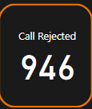
CALL CENTER KPI
01 - TOTAL CALLS
02 - CALL ANSWERED
03 - CALL REJECTED

Slide 9
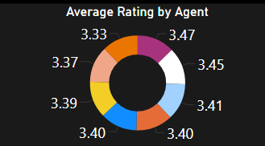
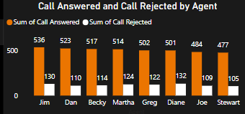
AGENT PERFORMANCE
BAR CHART: THIS CHART IS USED TO COMPARE THE TOTAL CALLS ANSWERED AND REJECTED BY EACH AGENT.
PIE CHART: THIS CHART IS USED TO DISPLAY THE AVERAGE RATING FOR EACH AGENT.

Slide 10
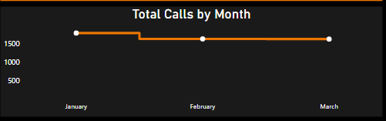
Line Graph: the total number of calls received per month for a call center.
CALL VOLUME ANALYSIS
Call volume peaked in January.
There was a significant decrease in calls from January to February.
Call volume remained relatively stable in February and March.
.

Slide 11
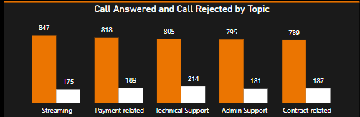
CALL TOPIC ANALYSIS
Streaming and payment-related calls are the most frequent types of inquiries.
Technical support, admin support, and contract-related calls have relatively similar volumes.
The number of calls rejected for each topic varies, indicating potential areas for improvement in call handling processes.

Slide 12
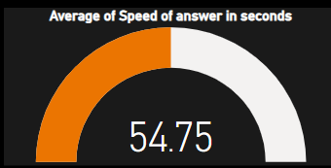
AVERAGE SPPED OF ANSWER

Slide 13
CHALLENGES FACED
Data Quality and Completeness
Data Privacy and Security
Choosing Appropriate Metrics
Interpreting Data insights

Slide 14
BENEFITS OF THE PROJECT
Improved agent performance
Optimized resource allocation
Enhanced customer satisfaction
Data-driven decision making

Slide 15
CONCLUSION
Data Science can uncover actionable insights from business operations.
The Call Center Analysis revealed opportunities to improve customer satisfaction and operational efficiency.

Slide 16
THANK YOU

